Slide 1

HummingBird
Name- Shreya Chadha
Reg. No.- 2427030458
Supervisor- Dr. Susheela Vishnoi

Slide 2



Project Summary
A guided creative ecosystem built for visual storytellers — designed to teach craft, amplify intention, and turn editing from task into expression.

Slide 3
Problem
Too complex or too automatic
Professional tools demand steep learning curves; consumer apps default to rigid templates.
Statement
Beginners miss craft
Relying on templates teaches workflows, not artistic reasoning or decision-making.
AI often replaces, not teaches
Generative systems produce outputs but rarely explain rationale or creative choices.

Slide 4
Literature Review & Market Research
We surveyed flagship editing tools (Photoshop, DaVinci, Premiere) and consumer apps (CapCut, InShot), plus emerging AI content platforms. Each offers strengths: depth, speed, or automation — but none combine guided pedagogy with hands-on editing.

Slide 5


Study Focus
Identified Gap
Capabilities, onboarding paths, and how tools teach (or fail to teach) reasoning.
No mainstream platform centers learning while editing with stepwise mentorship.

Slide 6

Project Goals
To bridge the gap between professional editing complexity and AI automation by building a creative platform that guides users in understanding and executing their artistic vision.
The goal of Hummingbird is to design and implement a browser-based creative studio that integrates:
Video editing tools
Preset-driven inspiration
Motion doodle animation
Conversational AI guidance

Slide 7
Research Gap — Our Innovation
Current tools skew toward either automation (fast outputs) or professional complexity (deep features). Hummingbird occupies a middle path: a learning-first, artist-centric ecosystem where AI mentors guide, not replace, the creative process.
Presets + Explanation
Motion Doodle
AI Mentor
Curated cinematic presets with contextual notes on when and why to use them.
Expressive doodle animation overlay to sketch ideas directly on frames.
Stepwise suggestions that teach grading, motion, and typographic choices rather than outputting finished content.

Slide 8
System Methodology
Hummingbird is modular by design — each module supports learning and experimentation while remaining composable for real projects.
Preset Inspiration Library
Editing Workspace
Reference reels, adjustable presets, and “show your work” notes explaining creative intent.
Non-destructive timeline with contextual tips and isolated practice modes.
AI Creative Mentor
Motion Doodle Studio
Interactive tutor offering incremental steps, explanation, and alternatives
Frame-based sketching tools with brush presets and simple keyframe animation.

Slide 9

Audience
Who
Beginner & Intermediate Visual Creators, Creative Education Sector, Social Media Creators
Key Insight
Creators do not struggle with ideas.
They struggle with translating ideas into execution.
Basis for key insight
Market observation of existing editing tools
Trend analysis of social media reels
Study of beginner learning curve in design tools
Behavioral shift toward AI dependence

Slide 10
Model & Architecture
Practical, client-heavy architecture focused on responsiveness, real-time feedback, and extensibility.
Frontend
Canvas Doodle
Filter Engine
Chat Workflow
React + Vite for a fast, modular UI with pluggable components and state-driven tutorials.
Canvas API powers frame-aligned doodle overlays and exportable SVG animations.
CSS-based filter pipeline for real-time color grading previews and adjustable presets.
Guided chatbot orchestrates step-by-step suggestions, checkpoints, and learning nudges to reinforce craft decisions.

Slide 11
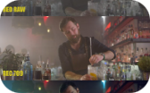



Comparison with Existing Solutions
Photoshop / DaVinci
CapCut / InShot
AI Generators
Hummingbird
Fast and template-driven — speeds production but often hides craft decisions from learners.
Produce outputs quickly but rarely explain creative choices or teach transferable skills.
Bridges the gap: guided learning built into the editing experience — educational, iterative, and composable.
Depth and precision — steep learning curve. Best for specialists who already know the rules.

Slide 12

Technical Stack
🔹 Frontend
🔹 Video Handling
🔹 Illustration Engine and Deployment
HTML5 – Structural layout
CSS3 – Styling, animations, filter effects
JavaScript (ES6+) – Application logic
React.js – Component-based UI architecture
Vite – Fast bundler & development environment
HTML5 <video> API
CSS filter engine for color grading simulation
Browser Object URLs for real-time preview
Canvas API (planned motion doodle overlay system)
Git
GitHub
GitHub Actions (CI/CD)
GitHub Pages (Hosting)

Slide 13
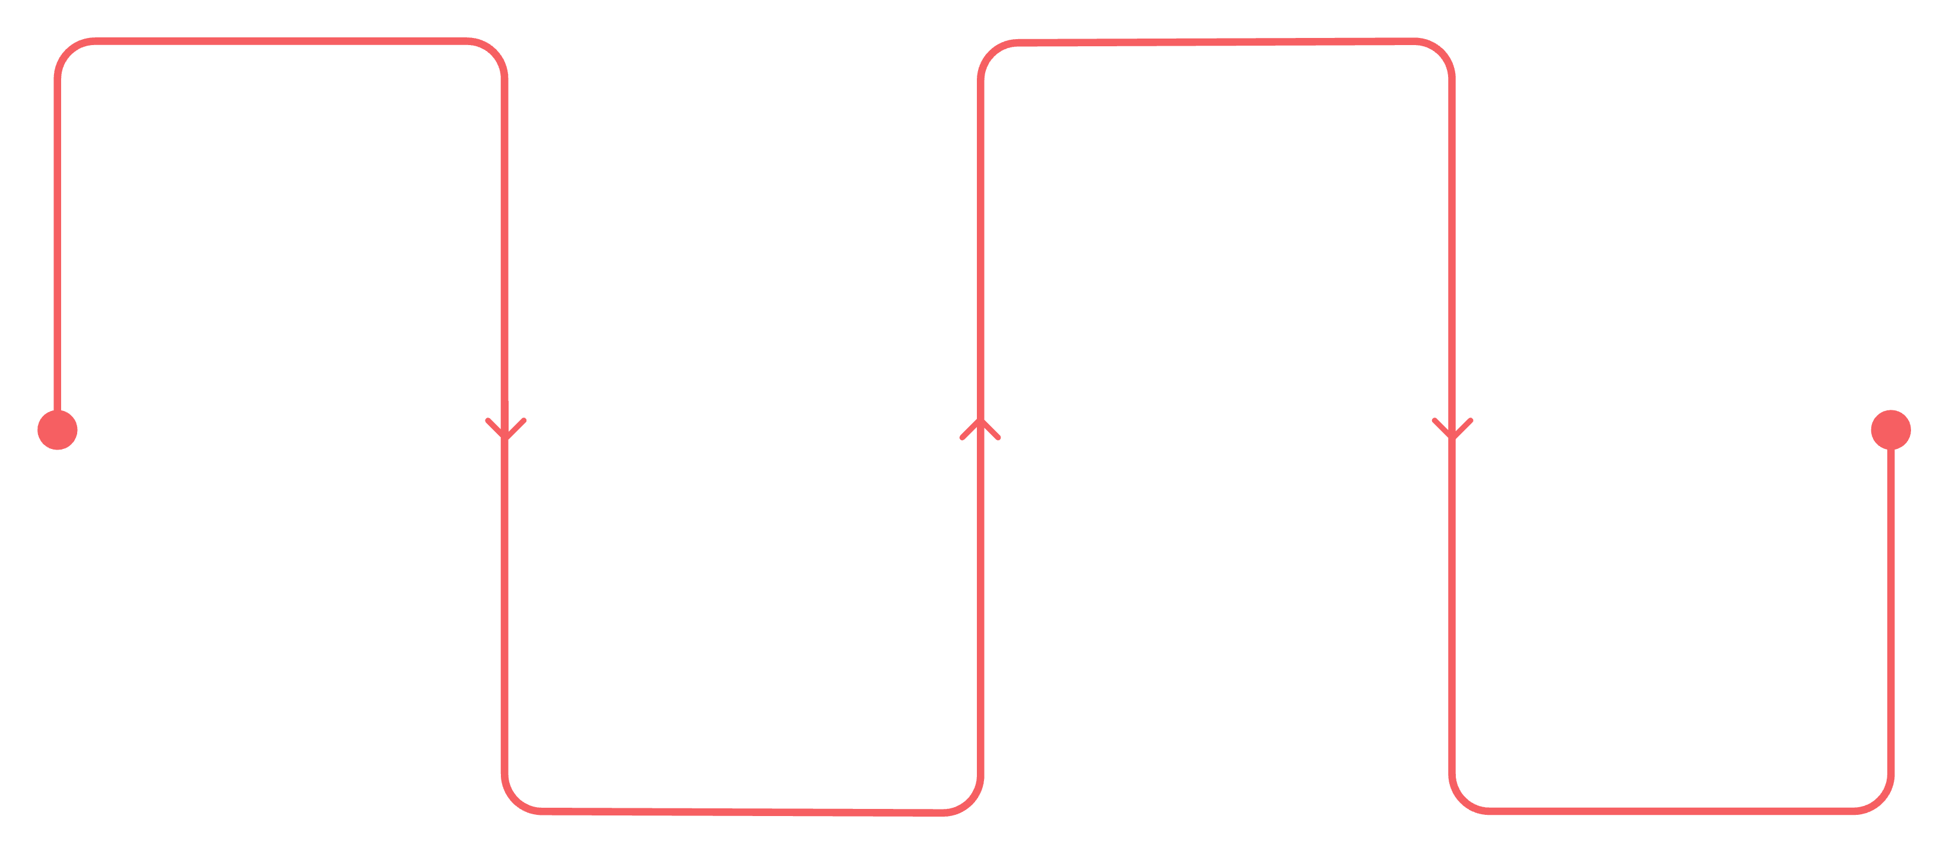
User Input Layer
Creative Processing Layer
Motion Doodle Studio
The workflow begins when the user:
Frame-based drawing system
🔹 Preset Inspiration Library
Animated artistic elements
Uploads a video file
🔹
Describes their creative vision using text
AI Creative Mentor
Output Layer
Provides editable cinematic presets
Suggests grading steps
All modifications are composited in-browser to produce:
🔹 Editing Workspace
🔹
Recommends typography & motion effects
Applies CSS-based transformations
Final Creative Output
Provides guided reasoning

Slide 14
Thank you.

